Slide 1
House Commission on Housing Affordability
October 17th, 2024

Slide 2
State Housing Plan

Slide 3
What is Housing 2030?
Housing 2030 is the name for the state housing plan we are developing
Aim is that this process will bring Rhode Islanders together to set concrete and measurable housing-related goals and align on strategies for making meaningful progress towards achieving these goals.
Housing 2030 is grounded in the existing and projected housing needs of Rhode Islanders and Rhode Island communities.
Housing 2030 aims to be an actionable plan that is not intended to sit on a shelf. It will do this by:
Creating and informing tools for Rhode Island communities to use
Serving as a roadmap for policy and budget proposals for FY2026 and beyond
Helping guide the State’s use of federal funds,
Becoming adopted as the State’s Guide Plan Element – which will inform municipal planning efforts for years to come

Slide 4
Process Overview
Builds upon initial options and observations described in the RI Foundation’s 2023 work with BCG.
Working with Abt Global (Abt is subcontracting with the Rhode Island League of Cities and Towns, Housing Works RI, and Root Policy)
Three phases to the process
Phase One: Baseline housing analysis which resulted in 2023 Integrated Housing Report
Phase Two: Housing needs, barriers, and housing planning/goal setting best practices
Phase Three: Recommended policies, goal setting, and resources
Housing needs, barriers, and assets
Resident Survey
Focus Groups
Stakeholder Consultations
Quantitative analysis
Policy research
Municipal meetings
Interviews

Slide 5
Housing 2030 Current Timeline
Advisory Group Meeting 1: Vision + Priorities
Advisory Group Meeting 2: Goals and metrics
Advisory Group Meeting 3: Strategies
Advisory Group Meeting 4: Draft plan
Publish plan + submit to statewide planning
Sept ‘24
State Planning Council discussion on where to encourage housing
Roundtable discussion on municipal goals and metrics
Public workshops

Slide 6
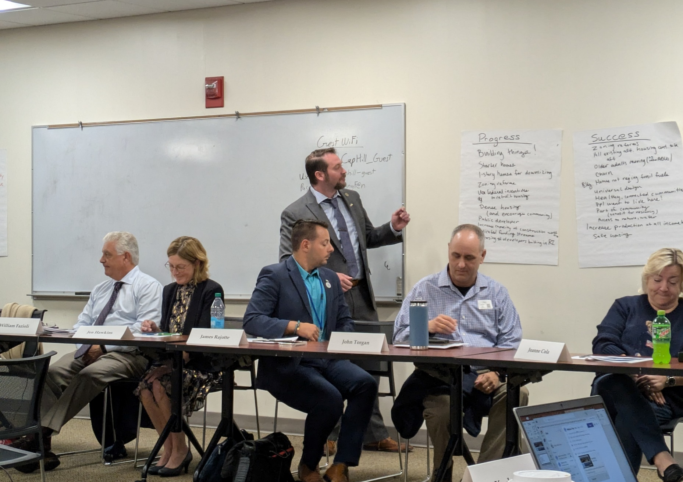
Advisory Group Meeting 1
Public meeting held in September, first convening of the advisory group
Discussion of draft vision and priorities
Draft vision presented – Produce and preserve housing to meet the needs of all Rhode Islanders
Draft priorities presented:
Housing stock
Affordability & Access
Homeownership
Homelessness

Slide 7
Housing in Rhode Island: Challenges and Recent Progress
Current Challenges
Over a decade of low housing production has led to a housing shortage
Median home sale prices have increased by more than 57% and average monthly rents have increased by more than 50% in the last 5 years
Unsheltered homelessness has grown significantly since the onset of COVID (~400 more individuals than in 2019)
Increased pressure on housing market from short term rentals
Recent Progress
Development and launch of the Department of Housing
Two rounds of legislative reform packages thanks to Speaker Shekarchi and the General Assembly
Historic investment into housing using the federal State Fiscal Recovery Funds (on pace to fund more than 2,300 units, more than 1,700 of which are affordable, over 250 middle income)
2,453 units permitted in 2023 (Housing Works RI permit survey), the most for Rhode Island since 2005

Slide 8
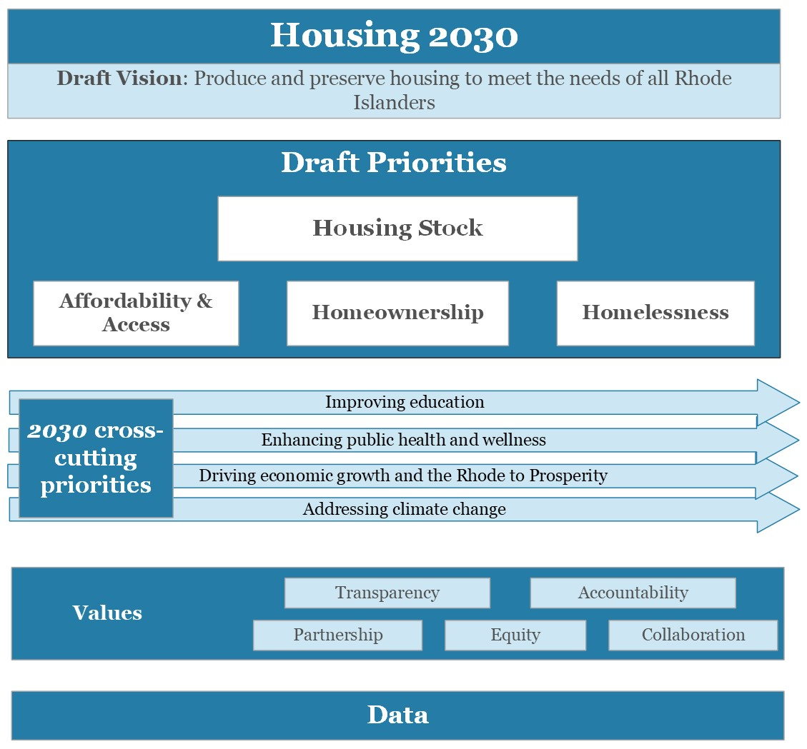
Draft vision and priorities

Slide 9
Rhode Island has a choice.
What kind of future does Rhode Island envision for itself?
Faced with these challenges and tradeoffs, Rhode Island must face some key questions as it creates a vision for itself.
Do we want to be a place where our children and grandchildren can afford to live both now and in the future?
Do we want to be able to retain our talented workforce?
Do we want to price even more Rhode Islanders out of the state?
Do we want to be a welcoming, diverse state?
Do we want to be a place where elders may age in community?
Draft vision: Produce and preserve housing to meet the needs of all Rhode Islanders

Slide 10
Housing Stock
What we heard from Rhode Islanders
What we heard from municipalities
78.4% of survey responses agreed that Rhode Island needs more housing (13.7% not sure)
The housing types they want to see built are included below:
Need for more housing
Concern about lack of housing for families, workforce, and seniors
Concern about external pressures on local housing market (short term rentals, out of state sales, student housing)
Strong interest in adaptive reuse, building upon existing footprint, while preserving conservation and open space
Limited and aging infrastructure to support housing development
Answer Choices | Preliminary Response Rate
Duplexes, triple-deckers, or townhomes | 58%
Mill conversions, office building conversions, or other types of conversions | 57%
Accessible housing options | 54%
Single family homes | 54%
Multi family apartment buildings (4+ apartments) | 52%
“Middle income families cannot afford to live here. The town is slowly dying.” – Survey response
n = 1,643

Slide 11
Housing Units Permitted
Source: Census Building Permit Survey – Housing Works RI

Slide 12
Housing Stock
Average new units required annually to match household formation, unit loss, and low-population growth is between 2,224 and 3,087
These estimates are a guidepost that represent the floor of production needed to prevent affordability issues getting worse.

Slide 13
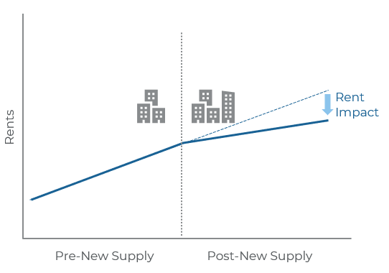
Housing stock
Reasons to focus
Housing production and preservation are essential strategies for achieving long term housing affordability
Vacancy rates in Rhode Island and growing housing prices signal a strong need for additional housing construction
Rhode Island’s housing production has only just begun to reach pre-Recession levels

Slide 14
Affordability & access
What we heard from Rhode Islanders
What we heard from municipalities
In focus groups and from the resident survey, affordability is the number one concern
Renters who were not satisfied with their current living situation shared the following reasons (survey responses)
Need for more housing that is affordable
Concern about children and grandchildren not being able to afford living in their community
Some communities are broadly supportive of more low-mod housing while others have other priorities
Desire to build affordable housing for seniors
Mixed reactions to the 10% rule across communities
Why are you not satisfied with your apartment? | Preliminary Response Rate
It’s too expensive | 46.6%
It doesn’t fit me or my family’s needs | 31.3%
My rental unit is in poor condition | 30%
Bad/rude/loud neighbors | 21%
My landlord won’t respond to my concerns | 17%
Crime in the neighborhood | 12%
It isn’t close enough to my family, friends, or employment | 10%
Cost of home repair/maintenance is too expensive | 6%
My home isn’t physically accessible | 5%
It isn’t close to transit | 5%
n = 249

Slide 15
Affordability & Access
New Low-Mod Units Granted COs 2017 - 2023
Estimated average annual net new households added through 2030, by Tenure and AMI
 | Rental | Ownership | Total
0%-30% AMI | 294 | 116 | 411
30% - 60% AMI | 255 | 251 | 507
60% - 80% AMI | 93 | 130 | 224
80% - 120% AMI | 171 | 379 | 551
120% + AMI | 181 | 866 | 1,047
Total | 995 | 1,744 | 2,739
Source: Root Policy Research, S&P Global Market Intelligence, ACS 2022 1-year estimates, U.S. Census 2023 National Population Projections, 2010 and 2020 Decennial Census, HUD 2017 Components of Inventory Change Report, HUD 2022 Statewide Income Limits
Source: Low-Mod Chart, Housing Works RI, RIHousing

Slide 16
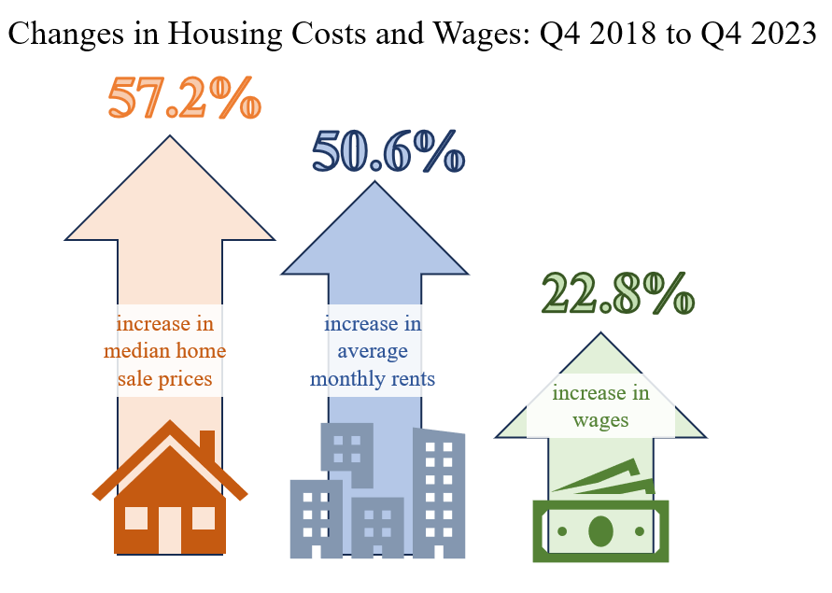
Affordability & access
Reasons to focus
Housing costs are rising much faster than incomes
More than one-third of Rhode Islanders are housing cost burdened
The growth of wages have not kept up with the increased in home sale prices and rents
A lack of affordable housing will price out Rhode Islanders and impede community and economic development

Slide 17
Homeownership
What we heard from Rhode Islanders
What we heard from municipalities
41% of renter households said they would like to buy a home but currently cannot (reasons below)
Homeownership units are not coming online because options for seniors to downsize are unavailable
Short term rentals and second homes are reducing available housing stock
Affordable starter homes are not being built, homeownership options are out of current residents’ price range
Concern about younger generation
Focus on communities with low homeownership rates
Answer Choices | Preliminary Response Rate
I cannot find any homes in my target price range | 75%
Interest rates are too high | 58%
I need a mortgage but available homes in my price range are sold to people who pay cash | 50%
I cannot find any suitable homes in the area where I want to live | 48%
I can afford the monthly expenses (mortgage, utilities, etc.) but not the down payment | 43%
My credit history would keep me from getting approved for a mortgage | 21%
I’m not interested in buying a home | 3%
n =482

Slide 18
Homeownership
Source: Zillow Housing Data
Source: HMDA Data

Slide 19
Homeownership
Reasons to focus
Homeownership offers stability, flexibility, and autonomy to individuals and families. These have meaningful impact on community development.
Homeownership is a wealth building tool
The racial and ethnic homeownership gap in Rhode Island are in part due to current and historical discrimination and effects of redlining

Slide 20
Homelessness
What we heard from Rhode Islanders
What we heard from municipalities
Homelessness is a deeply concerning humanitarian and public health issue
Resident survey responses shared concerns about homelessness in their community and about their own experiences with homelessness
Affordability challenges due to changes in work, loss of income, and rising rents were cited as primary reasons for homelessness
Homelessness is a growing concern in some communities
Other communities are unaware of local homelessness
Need for state support for long term solutions as well as short term supports

Slide 21
Homelessness
Source: HUD Housing Inventory Count

Slide 22
Homelessness
Reasons to focus
Since the onset of the COVID-19 pandemic, homelessness (particularly unsheltered homelessness) is growing in Rhode Island
Homelessness has serious impacts on individual’s health and community health
Research demonstrates that rental vacancy rates are strongly associated with homelessness, indicating that increased production helps reduce homelessness
Source: HUD Point in Time Count

Slide 23
Feedback from Advisory Group Meeting 1
Top Priority: Increasing Housing Production
Draft vision presented – Produce and preserve housing to meet the needs of all Rhode Islanders
Updated draft vision – Produce and preserve housing to meet and respond to the needs of all Rhode Islanders; with a focus on creating a diversity of housing options, affordability, and accessibility.
Particular focus on increasing housing production and recommendation to call out preservation more explicitly in goal development (see figure)
Additional feedback on what success and progress look like under each priority
Additional Priorities
Production
Preservation
Affordability & Access
Homeownership
Homelessness
Improving education
2030 cross cutting priorities
Enhancing public health and wellness
Driving economic growth and the Rhode to Prosperity
Addressing climate change
Values
Transparency
Equity
Collaboration
Partnership
Accountability
Data

Slide 24
Upcoming Dates
Upcoming dates
Presentation at State Planning Council – November 14th (meeting runs from 9 – 10:30 AM)
Feedback from Council on where to encourage housing development
Advisory group 2 meeting – November 21st from 9 – 11 AM
Housing goals and metrics
Advisory group 3 meeting – December 18th from 1 – 3 PM
Strategies to support achieving goals

Slide 25
Feedback or Questions?
Email Patrick Duffy at Patrick.s.duffy@housing.ri.gov

Slide 26
SFRF Projects and Programs

Slide 27
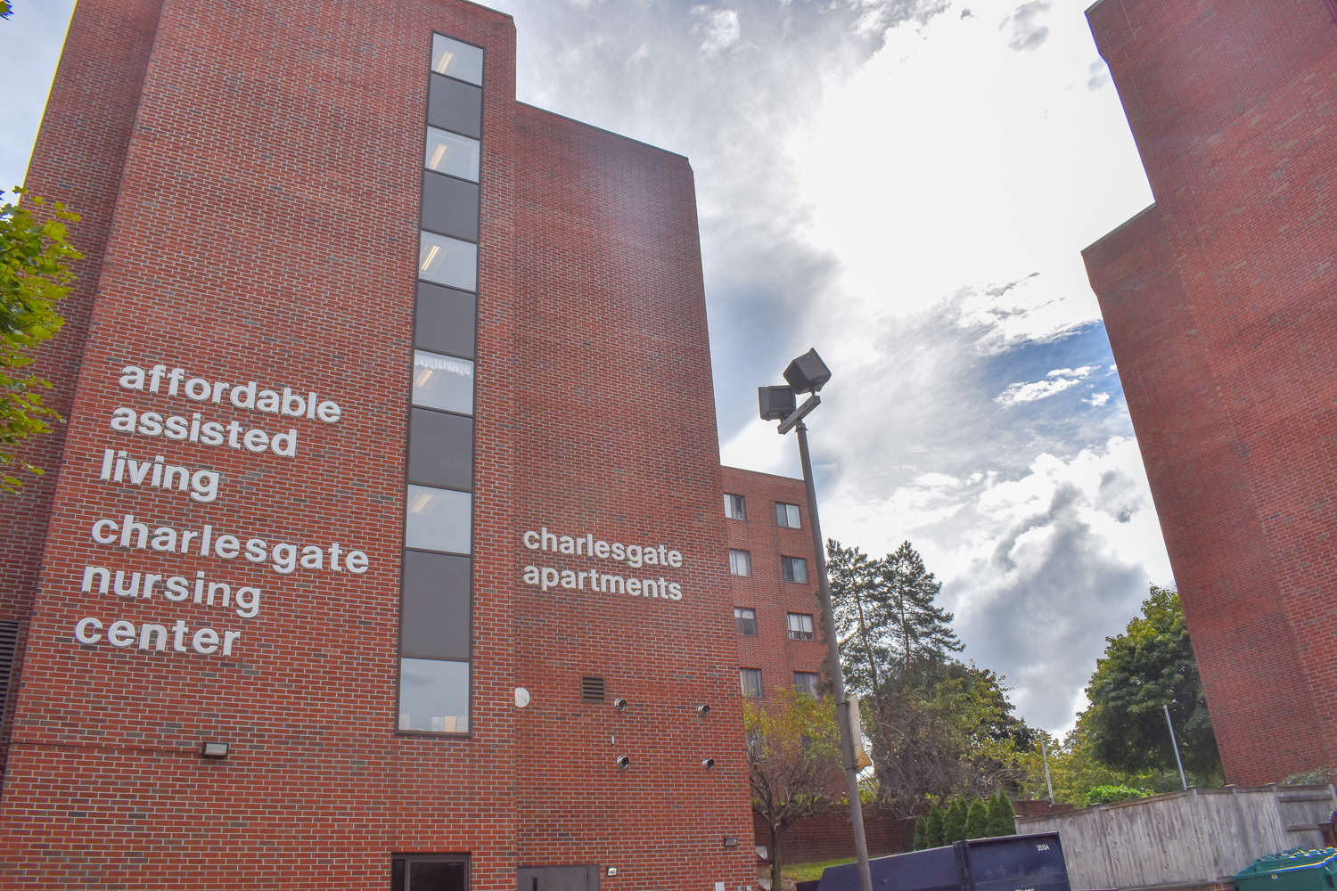
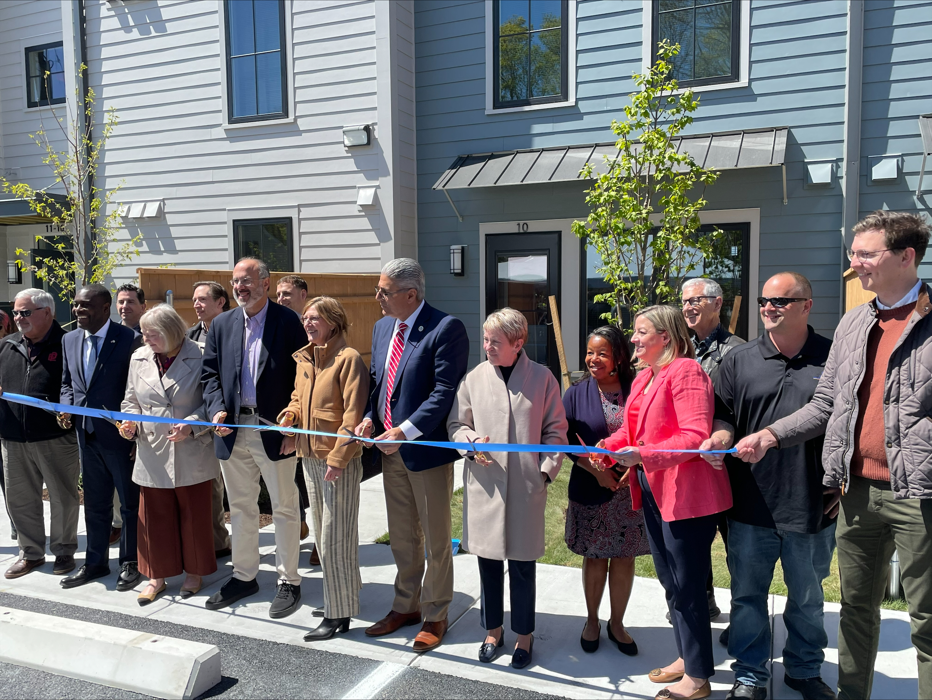
SFRF Accomplishments To Date
This money is actively being deployed to help Rhode Islanders. Even though it takes time to build new housing, these investments are generating progress.
New & Preserved Housing | 2,320 housing units financed. Includes 2,107 affordable units. Includes 176 affordable, permanent supportive apartments exclusively for formerly homeless adults.
Homelessness Response | 32% or 338 bed net increase in shelter beds for 2023-24 Acquired former Charlesgate facility Accepting applications for 2nd round of municipal homelessness support
New Homeowners | The Downpayment Assistance Program provided $17,500 to first time homebuyers. This program helped over 1,600 Rhode Islanders across 35 municipalities purchase their first homes.

Slide 28
SFRF Housing Progress Dashboard
Highlights our key accomplishments
Provides program descriptions, status updates, and information about commitments and spending.
Directs to additional detail on RI Housing-financed programs

Slide 29
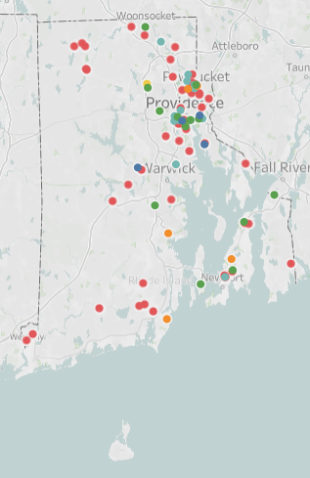
Development Projects Map – RIHousing Dashboard
Completed – Project has finished construction and is ready for occupancy
Under Construction – Project financing has closed and construction has begun
Firm Commitment – RIHousing board has given their final approval to the project and the developer is working toward closing
Preliminary Commitment – RIHousing board has approved the project and the developer is working towards firm commitment
Pre-financing – project has received SAP, Predevelopment, PHA financing

Slide 30
Construction progress
Committed projects progressing, despite national development challenges
69 units complete and 932 units under construction.
Typical projects funded to date are taking 26-34 months to complete construction, following funding approval
National development challenges:
Increasing construction & financing cost
Decreasing tax credit syndication pricing
Supply chain issues
Unanticipated site conditions
Monitoring project progress to ensure projects stay on track.

Slide 31
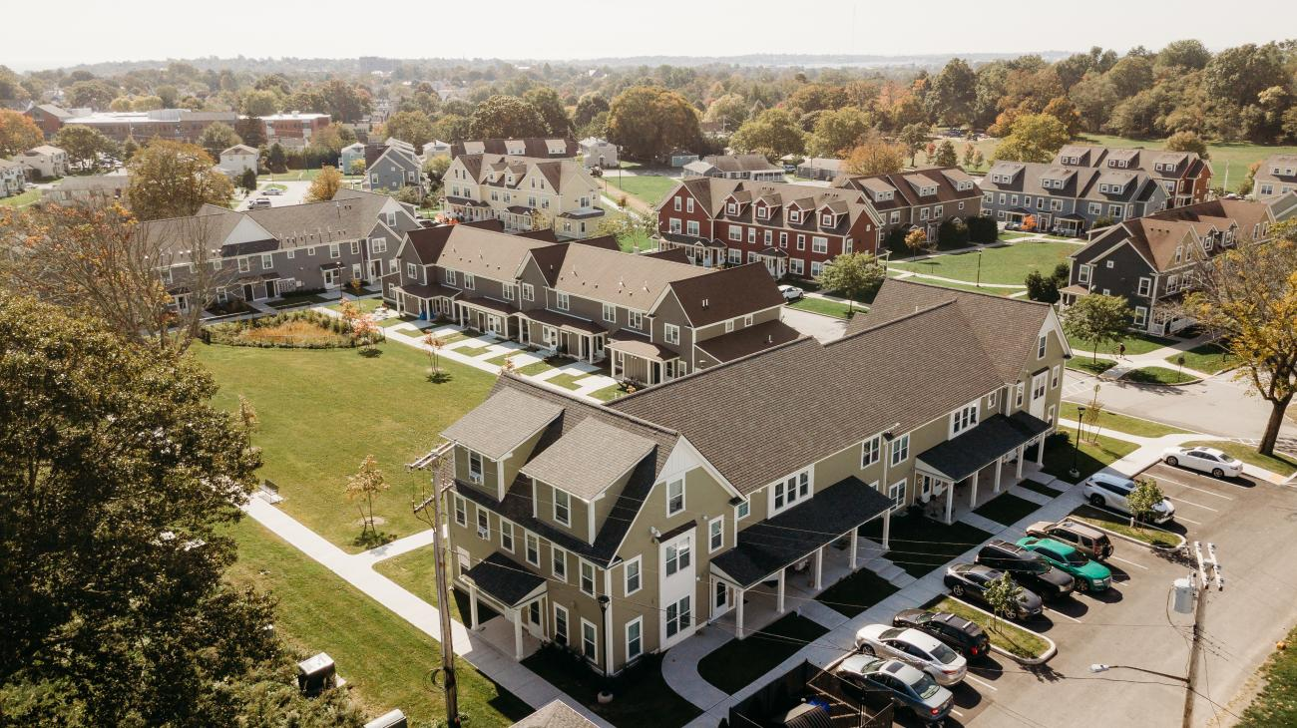
One Stop Application
Request for Proposals issued by RIHousing for the development of affordable housing
The RFP includes funds from the following sources:
Low-Income Housing Tax Credit (LIHTC)
State LIHTC
HOME and HTF (HUD Funding)
Project Based Rental Assistance (Section 811)
SFRF Funds: Middle Income, Development of Affordable Housing
Housing Production Funds
Application is opening today (October 17th) and will be open through 4 PM on December 16th

Slide 32
Home Repair Program
Program administered by the Providence Revolving Fund
Grant funds for home repairs (forgivable loans over a five year period)
1-2 units may apply for up to $50,000 and 3-4 units may apply for up to $75,000
Properties must be in a Qualified Census Tract or in Providence
Program has income eligibility requirements and is not limited to owner-occupied properties
Application is currently live: https://www.revolvingfund.org/rihrp

Slide 33
Municipal Fellows
Program Description
Municipalities apply for up to $168,000 to offset the cost of hiring one Fellow
Fellowship terms of up to 2 years
Fellows to work on municipal planning, zoning, or development activities directly related to increasing housing development
Program Status Update
Eight municipalities have applied to the program
Two municipalities provided conditional awards through Municipal Fellows program (other applications under review)
Newport and Coventry
Program is oversubscribed on the municipal side.
Currently working on municipal fellow recruitment

Slide 34
Appendix

Slide 35
Housing SFRF Spending Progress
99.6% of Housing SFRF funds are expended, committed or pending award.
Key Definitions
Expended – Funds disbursed
Committed – Funds budgeted towards a project selected through an award process
Pending Award – Funds connected to an open RFP or an RFP currently under review
Remaining Funds

Slide 36
Housing Production and Preservation
Updates
Funding for over 2,100 affordable housing units
All funds were awarded to qualifying development projects in the May consolidated funding round led by RIHousing
Remaining $1.9M from the Middle Income program to be awarded to eligible projects in next consolidated funding round
Home Repair program launched – Providence Revolving Fund is administering the program and currently receiving and reviewing applications
SFRF Programs
Community Revitalization
Development of Affordable Housing: Phases 1 and 2
Home Repair
Middle Income Housing
Permanent Supportive Housing: Crossroads
Preservation of Affordable Housing
Priority Projects Fund
Public Housing Pilot Program
Transit-Oriented Housing
Expended | Committed | Pending Awards | Remaining Funds
$45,9M | $124.5M | $8.7M | -

Slide 37
Generating New Project Pipeline
Updates
Five infrastructure projects approved by the RI Infrastructure Bank
Two municipalities provided conditional awards through Municipal Fellows program (other applications under review)
Currently working on municipal fellow recruitment
Hired a president for the proactive housing development entity at RIHousing
Site acquisition awarded to 39 projects in 22 municipalities
Funding for eight public housing TA and predevelopment projects has been awarded
SFRF Programs
Housing Related Infrastructure
Municipal Fellows
PHA Technical Assistance and Predevelopment
Proactive Housing Development
Site Acquisition
Statewide Housing Plan
TOD Zoning Municipal Technical Assistance
Expended | Committed | Pending Awards | Remaining Funds
$33,1M | $4.8M | $6.6M | $1M

Slide 38
Homelessness
Updates
$17M additional SFRF funds awarded for FY2025, included in recent consolidated homelessness funding application
Applications currently being reviewed and awards are being made
Municipal homelessness support initiative application launched on September 17th, closes at the end of October or when all funds are obligated
Funds for public safety expenses and other municipal services that support individuals and families experiencing homelessness
SFRF Programs
Homelessness Assistance: Phases 1, 2, 3,
Homelessness Assistance: Warming Center and Shelter
Homelessness Infrastructure: Phases 1 and 2
Municipal Homelessness Support Initiative
Expended | Committed | Pending Awards | Remaining Funds
$35M | $38M | $3M | -

Slide 39
Homeownership – Downpayment Assistance Program
Updates
All funding committed through the Downpayment Assistance Program
Provides grants of $17,500 to first time homebuyers
Grants to 1,672 first time homebuyers in 35 municipalities
Program is closed
Expended | Committed | Pending Awards | Remaining Funds
$29.9M | $0.01M | - | -

